Slide 1
Power System Planning
Lecture No.4
Prof. Dr. Muhammad Kamran
mkamran@uet.edu.pk

Slide 2
Lecture contents
Electric power distribution system
All concerned definitions and Problems

Slide 3
Connected Load
It is the sum of continuous ratings of the load consuming apparatus connected to the system
Demand factor DF is the ratio of the maximum demand of the system to the total connected load of the system, Therefore, the demand factor is ;
DF= Maximum demand/ Total connected load

Slide 4
Utilization Factor
It is the ratio of demand of a system to the rated capacity of system
Utilization factor is ;
Maximum demand/rated system capacity
The utilization factor can also be found for a part of the system
The rated system capacity may be selected to be the smaller of thermal or voltage drop capacity

Slide 5
Capacity Factor
A base load power plant with a capacity of 1,000 megawatts (MW) might produce 648,000 megawatt-hours (MW·h) in a 30-day month
The number of megawatt-hours that would have been produced had the plant been operating at full capacity can be determined by multiplying the plant's maximum capacity by the number of hours in the time period. 1,000 MW × 30 days × 24 hours/day is 720,000 MW·h
The capacity factor is determined by dividing the actual output with the maximum possible output. In this case, the capacity factor is 0.9

Slide 6


Slide 7
Plant Factor/ Capacity Factor
It is the ratio of the total actual energy produced or served over a designated that period of time to the energy that have been produced or served if the plant had operated continuously at maximum rating
It is also known as the capacity factor or the use factor
Therefore;

Slide 8
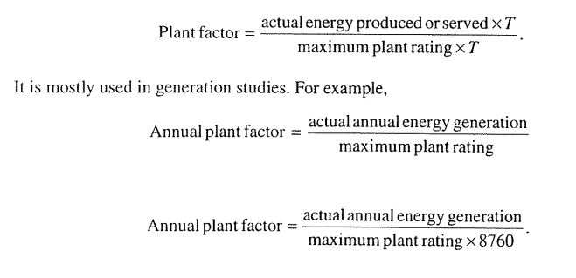

Slide 9
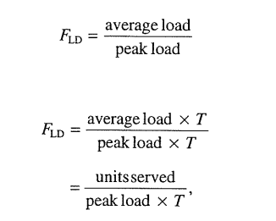
Load Factor is the ratio of the average load over a designated period of time to the peak load occurring on that period
Therefore, load factor F_{LD} is the ratio of the average load to peak load;

Slide 10
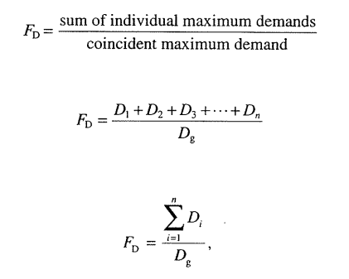
Where T is the time, in days, weeks, months or years
Annual Load Factor=Total annual energy/(annual peak loadX8760)
Diversity factor---is the ratio of the sum of the individual maximum demands of the various subdivisions of a system to the maximum demand of the whole system, therefore Diversity factor is;

Slide 11
Coincident Demand
Coincident peak demand is the energy demand by that group during periods of peak system demand.
Coincident peak demand is the energy demand by that group during periods of peak system demand
Loosely speaking, it refers to demand among a group of customers that coincides with total demand on the system at that time

Slide 12
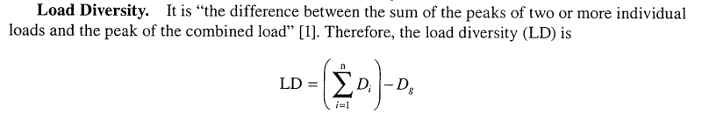

Slide 13
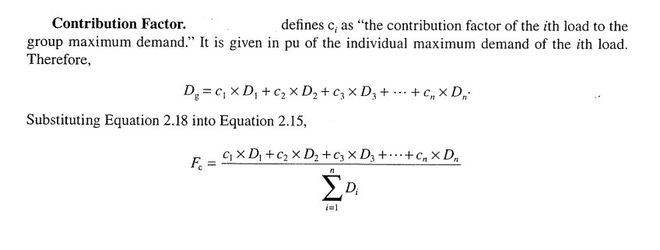
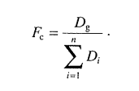

Slide 14
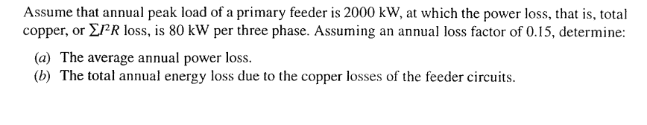
Non coincident Demand
The sum of demands of a group of loads with no restrictions on the interval demand is applicable

Slide 15
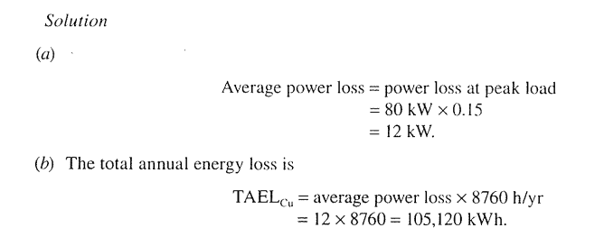
Solution

Slide 16
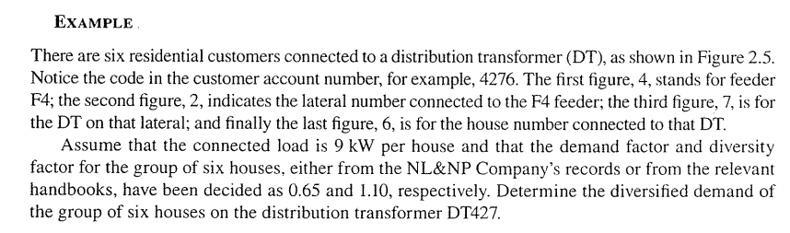
Problem

Slide 17
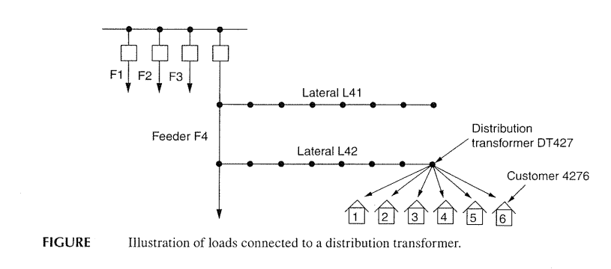

Slide 18
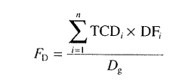
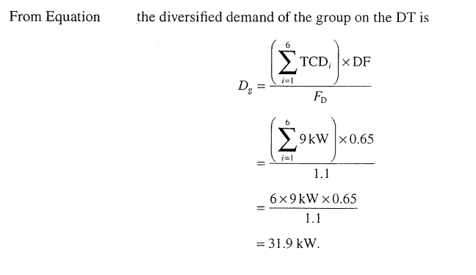
Solution
TCD=Total Connected Demand
DF= Demand Factor
Dg=Diversified demand

Slide 19
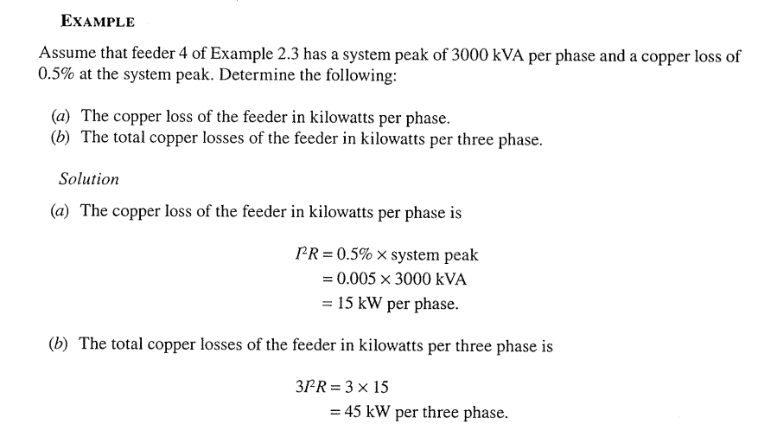

Slide 20
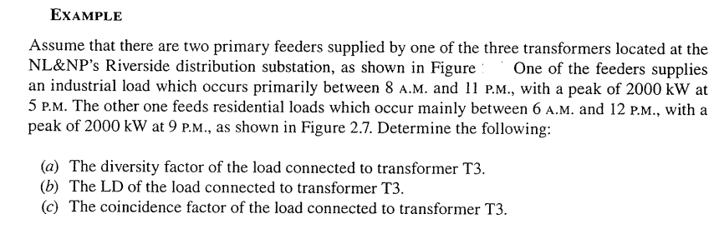

Slide 21
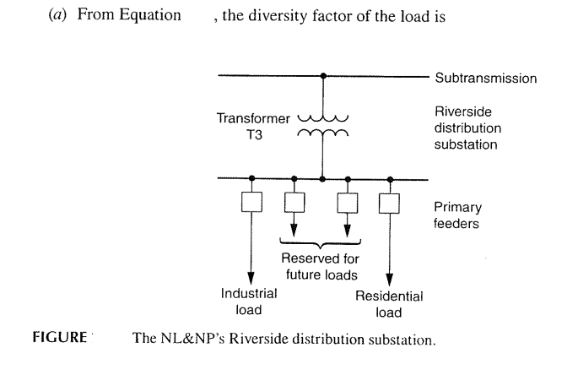
Problem

Slide 22
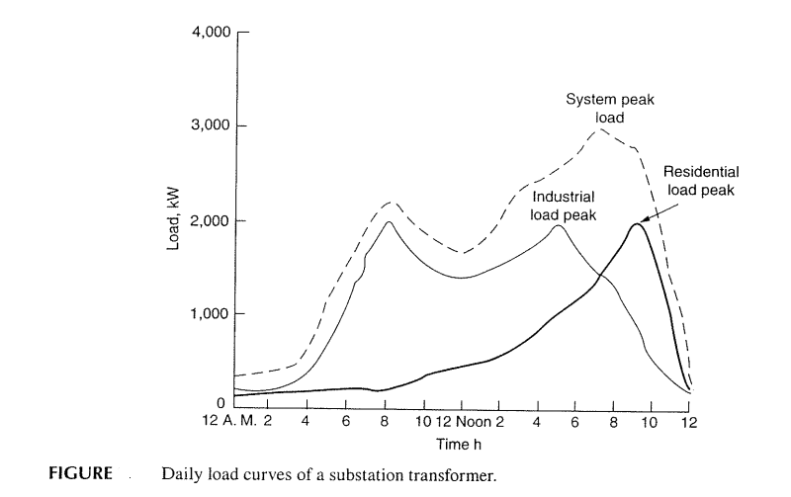
Fig. 2.7

Slide 23
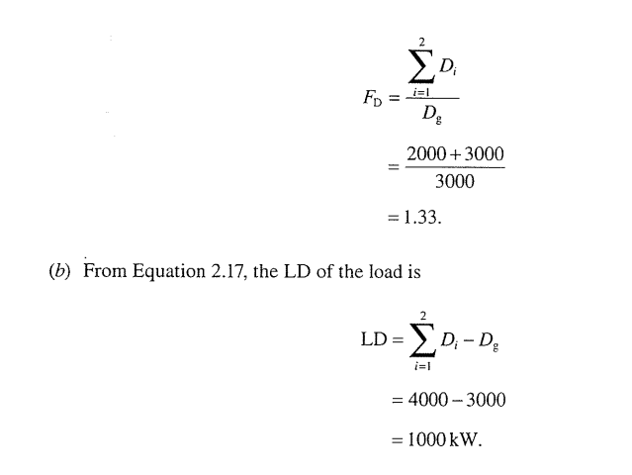
LD-Load Diversity
Fd= 2000+2000/3000

Slide 24
Coincidence factor; F_{c}= 1/F_{d}
F_{c}= 1/1.33=0.752;

Slide 25
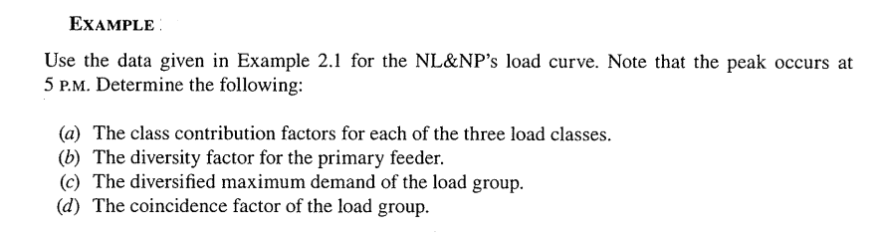

Slide 26
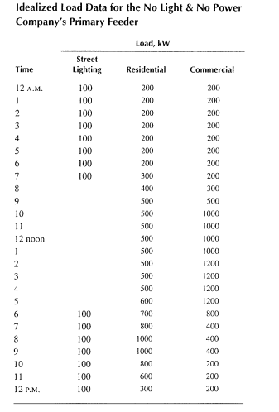

Slide 27
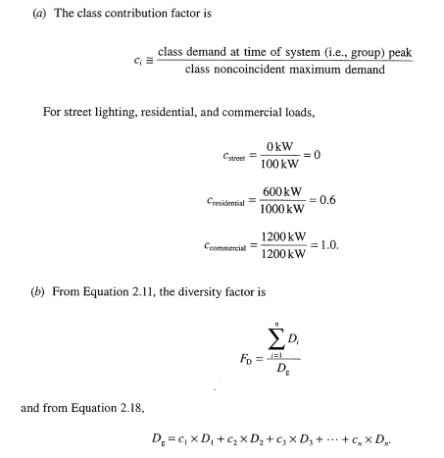

Slide 28
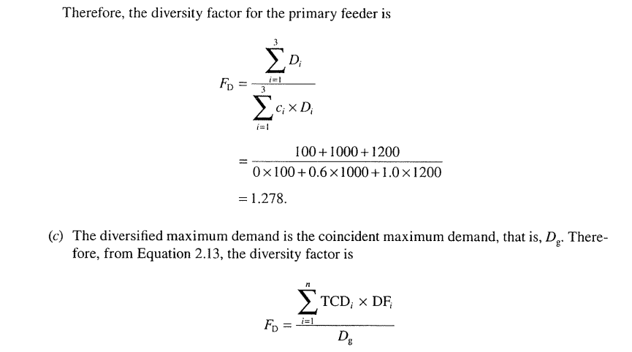

Slide 29
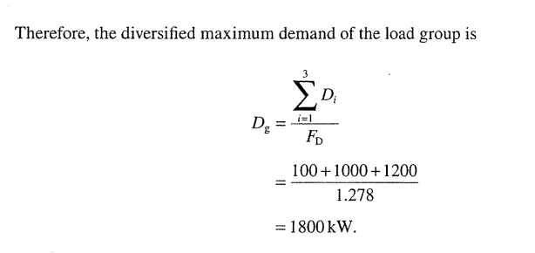
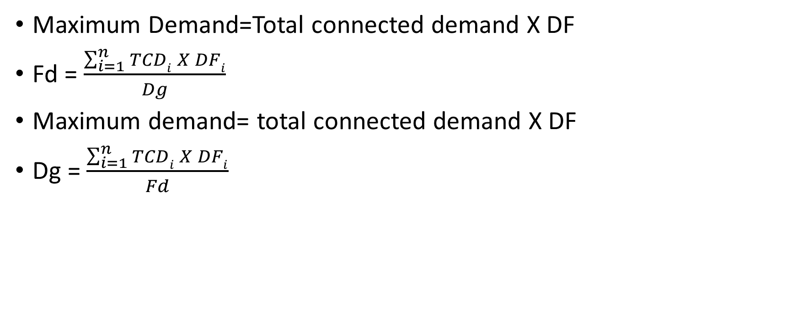
Maximum Demand=Total connected demand X DF
Fd = $\frac{\sum_{i=1}^{n}{TCDi X DFi}}{Dg}$
Maximum demand= total connected demand X DF
Dg = $\frac{\sum_{i=1}^{n}{TCDi X DFi}}{Fd}$

Slide 30
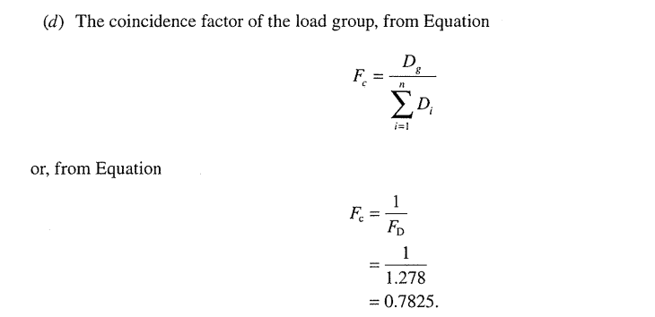

Slide 31
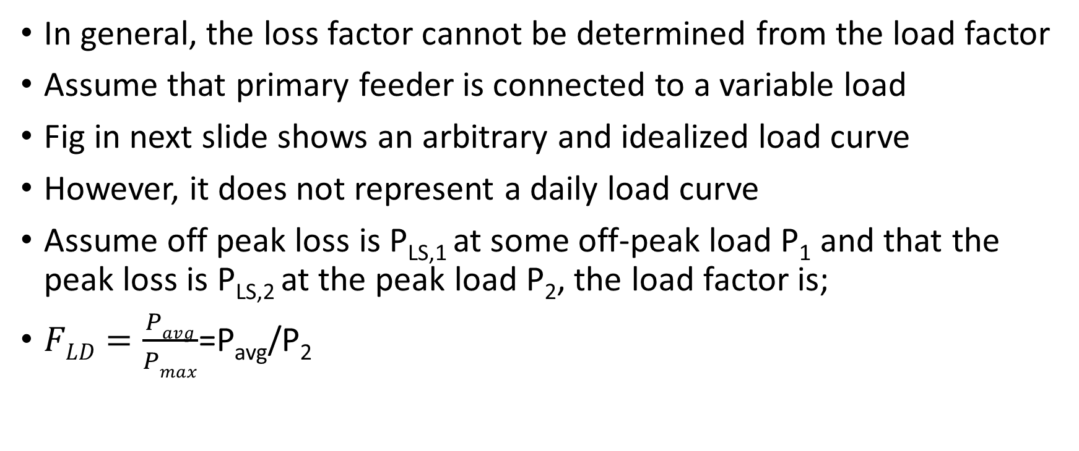
Relation between Load and Loss factor
In general, the loss factor cannot be determined from the load factor
Assume that primary feeder is connected to a variable load
Fig in next slide shows an arbitrary and idealized load curve
However, it does not represent a daily load curve
Assume off peak loss is P_{LS,1} at some off-peak load P₁ and that the peak loss is P_{LS,2} at the peak load P₂, the load factor is;
$FLD=\frac{Pavg}{Pmax}$=P_{avg}/P₂

Slide 32
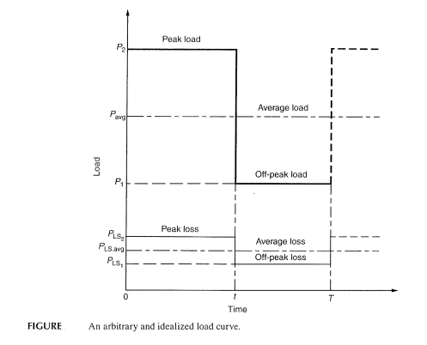

Slide 33
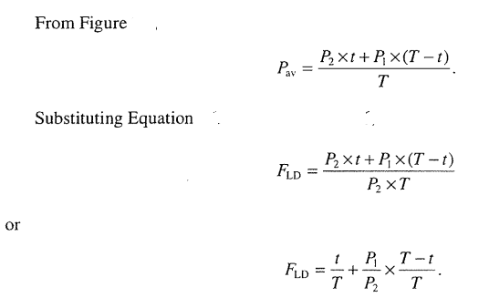

Slide 34
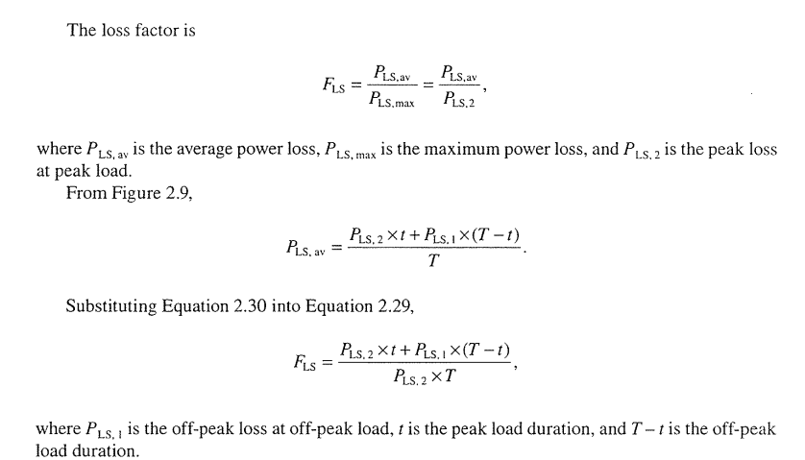

Slide 35
The copper losses are the function of the associated loads
Therefore, the off peak and peak loads can be expressed, respectively, as;
P_{LS,1}=k X P₁²
P_{LS,2}=k X P₂²
Where k is constant
Substituting equations, F_{LS} will be;

Slide 36
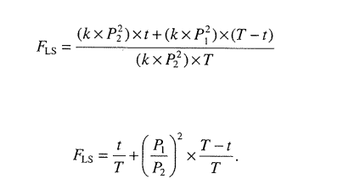

Slide 37
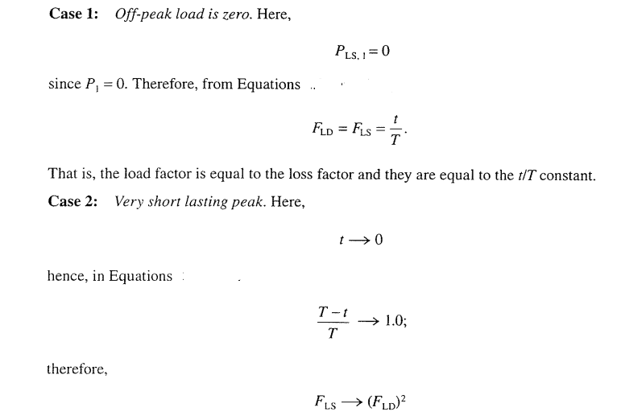

Slide 38
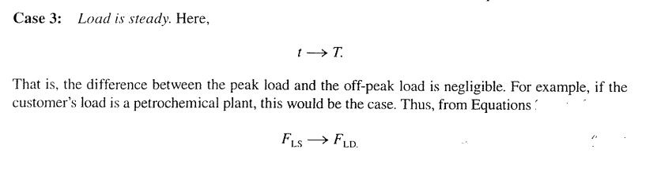

Slide 39
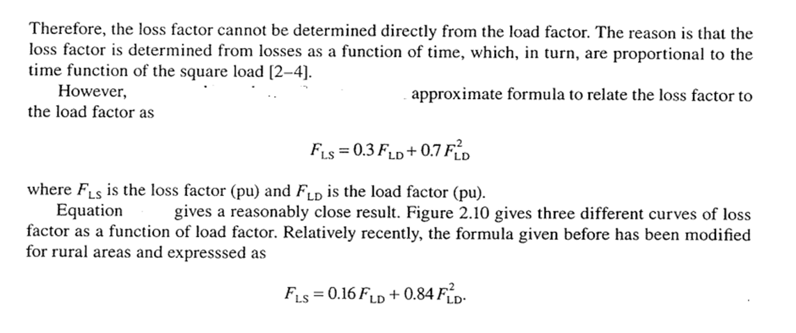

Slide 40
Load-loss factor
Load-loss factor (LLF) is a factor which when multiplied by energy lost at time of peak and the number of load periods will give overall average energy lost
It is calculated as the ratio of the average load loss to the peak load loss

Slide 41
Why these calculations are important
Electric distribution utilities observe the considerable increase of the technical and nontechnical losses in their network
Thus utilities need to look for more accurate tools for loss calculation
In order to select the optimal solution for loss reduction, need to have loss estimation or calculation models

Slide 42
Example
Using a large commercial electrical bill:
peak demand = 436 kW
use = 57200 kWh
number of days in billing cycle = 30 d
Load factor = { 57200 kWh / (30 d × 24 hours per day × 436 kW) } × 100% = 18.22%

Slide 43
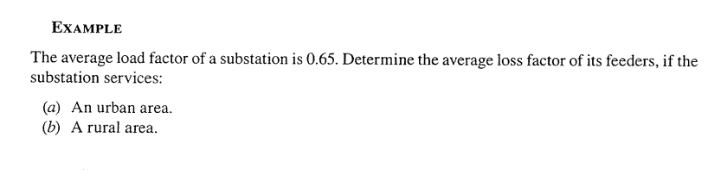

Slide 44
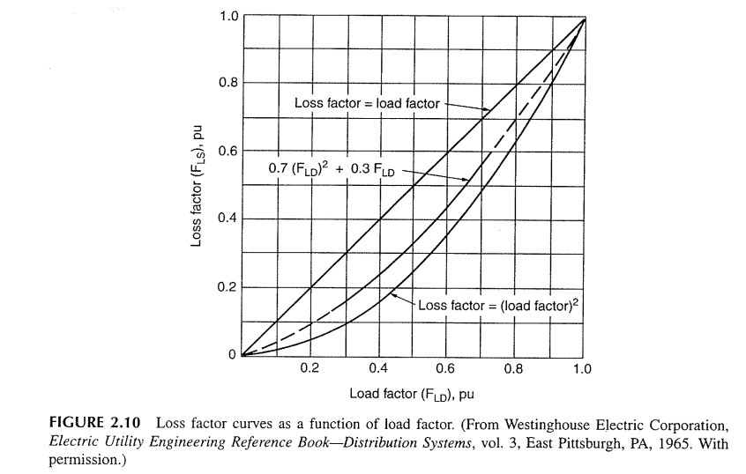

Slide 45
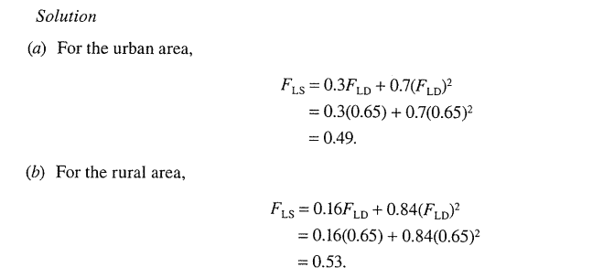

Slide 46
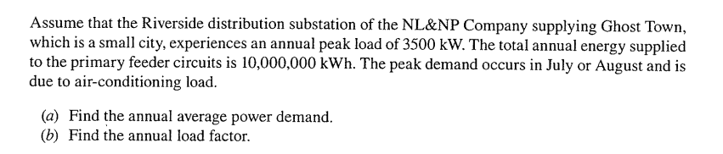
Example

Slide 47
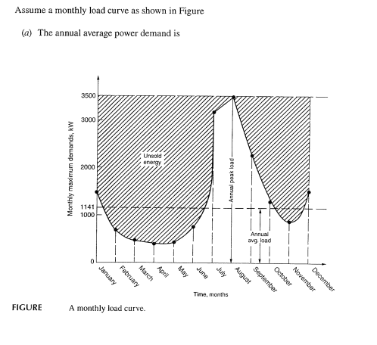
Solution

Slide 48
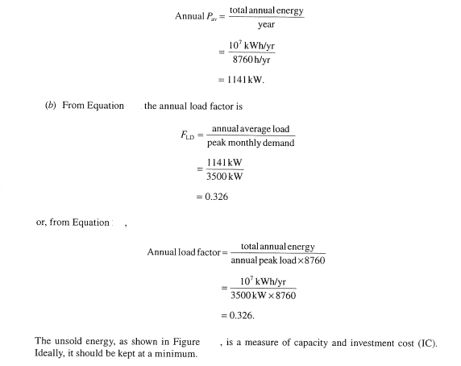

Slide 49
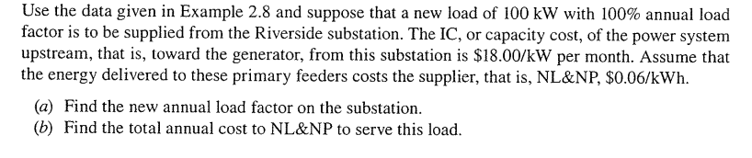
Example

Slide 50
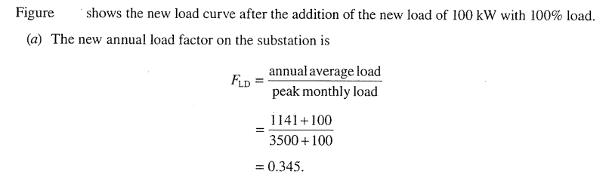
Solution

Slide 51
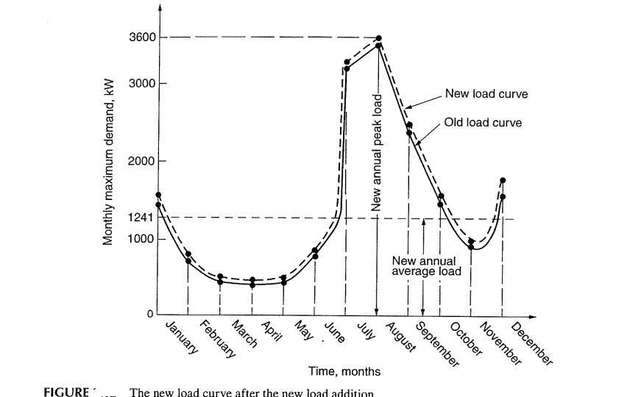

Slide 52
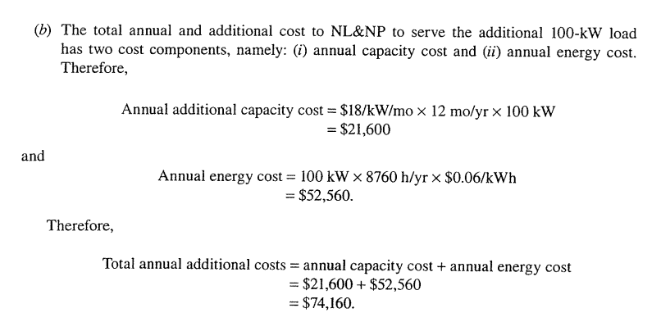

Slide 53
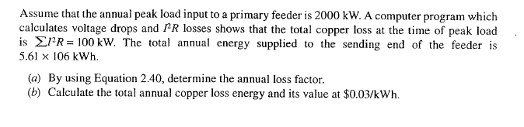
EXAMPLE

Slide 54
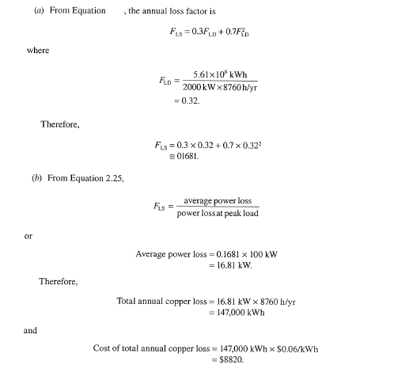

Slide 55
Example

Slide 60
Discussion will be continued…….

